Slide 1
EXISTING EXPERIENCE IN
CROSS-BORDER COOPERATION
SLOVAKIA-UKRAINE
ARD «TRANSCARPATHIA»
KICK-OFF CONFERENCE
Kosice, Slovakia
March 9, 2016

Slide 2
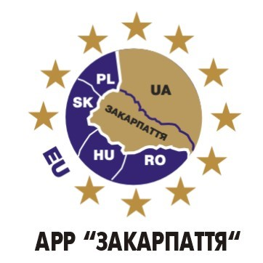
Communal enterprise
«agency of regional development and cross-border co-operation “Transcarpathia” of Zakarpattia oblast council»
The Agency is established by the Zakarpattia Oblast Council
January 11, 2002
Main tasks:
Developing of cross-border cooperation in the Carpathian region;
Contributing to regional development of Zakarpattia oblast;
Attracting of investments and international technical assistance into the region.

Slide 3
Legal documents:
International and bilateral agreements
Strategies, concepts
Regional sectoral program documents

Slide 4
Participation in cross-border and international programs 2003-2016
ТАCІS CBC;
FARE CBC;
Program CADSES INTERREG III B;
NP Hungary-Slovakia-Ukraine 2004-2006;
South-East Programme;
Norwegian Financial Mechanism Programme;
Hungary-Slovakia-Romania-Ukraine ENPI CBC Programme 2007-2013

Slide 5
Cross-border cooperation experience

Slide 6
Sk-UA Cross-border cooperation experience

Slide 7
joint strategies and programs elaboration
Programme – ТАCІS CBC:
PROJECT “Carpathia 2003-2011 – introduction of the strategic approach to cross border co-operation development in Carpathian region”:
Carpathia 2003-2011 Strategy was developed by the experts from the CBC target regions (RO, HU, SK, PL, UA)
PROJECT “A Bridge across Slovakia and Ukraine border”:
Developing of cooperation with Kosice self-governing (SK) and with Modena region (It);
Establishing of foundations for further cooperation in International and cross-border projects, joint regional and local development programs elaboration;
guidebook “Contributing to the local development in cross-border area”.

Slide 8
Study of development and utilization opportunities of renewable sources of energy
Neighborhood Programme 2004-2006
PROJECT “Study on complex biomass treatment in common cross-border region Hungary-Slovakia-Ukraine (Feasibility study) ”:
Concept on complex biomass treatment in Zakarpattia;
Guidebook on legal provision of biomass usage
Programme CBC ENPI 2007-2013
PROJECT «Bioenergy of the Carpathians»:
Forming partnerships between consumers and producers or consumers of biomass, including cross-border level;
Foundation of the Alternative Energy Sources Development Center in Zakarpattia oblast;
Strengthening experience exchange with countries, where biomass energy is utilised

Slide 9
Environment protection
Neighborhood Programme INTERREG ІІІА
PROJECT “Pure water”
Construction of purifying facilities in Kinchesh, Chaslivtsi and Korytniany villages;
Study and analysis of modern technologies of water purification in the countries of Western Europe;
Forming of the database of local self-government bodies of the target territory;
Developing of the recommendations on the methods of solving the problem of water supply, water drain and sewage water purification for Uzhhorod district.

Slide 10

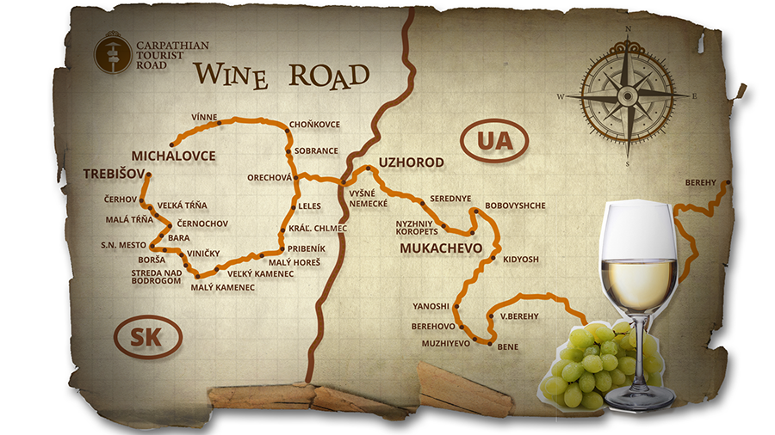
Increase and improve the level of tourism development in carpathian region
Programme CBC ENPI 2007-2013
PROJECT “Carpathian Tourist Road”
Wine, cycle and hiking cross-border trails were developed;
The web-site http://www.carpathianroad.com was created;
Trainings for tourists actors were carried out;
Book «Nevytsky Castle. Excursion to the Middle Ages and the problems of the XXI century”.

Slide 11

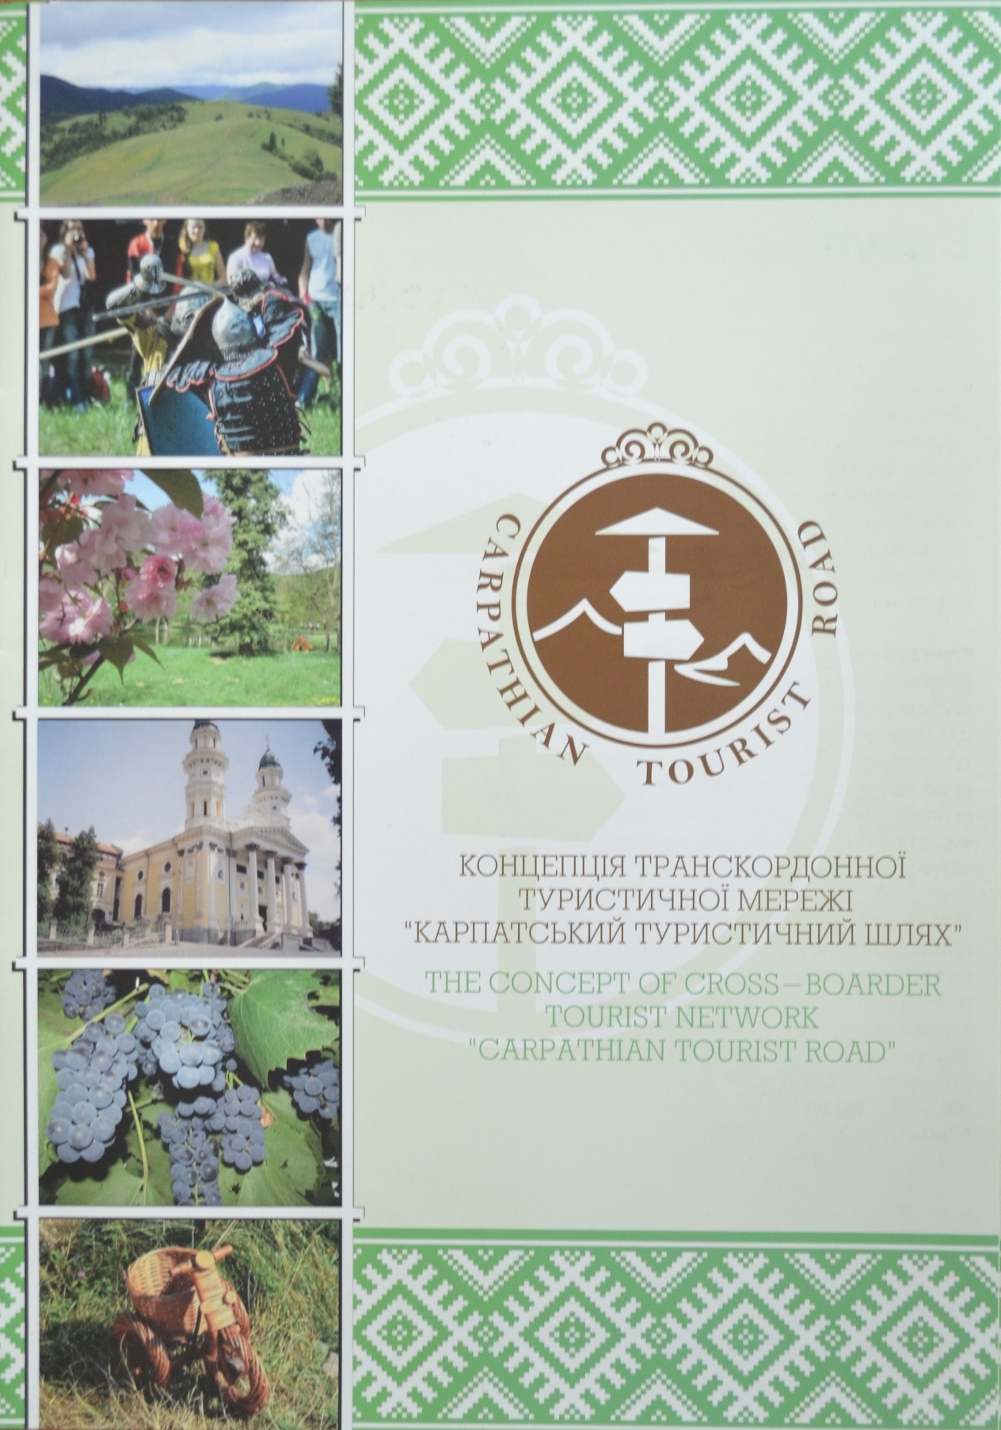
Increase and improve the level of tourism development in carpathian region
PROJECT “Carpathian Tourist Road 2”
Cross-border tourism network “Carpathian Tourist Road” was established and the mechanism of its function was elaborated;
ARD “Transcarpathia” became a member of European Rambler's Association;
“Tourevrocenter-Zakarpattia 2014” International Tourism Fair and Exhibition was co-organized;
CTR regular in “Unikum” magazine was created;
Books “Exploring the museums of Transcarpathia” and “Transcarpathia: land close to the sky” was published

Slide 12
Norwegian financial mechanism
PROJECT «Іkarus»
Educational activities – focused on communication, project preparation and management;
Establishing of two offices in the microregions;
Develop or update the development strategies of the selected border microregions (partially in Zakarpattia);
Develop or update the development strategies of the microregions of Borolo, Koroml’a and Trojhranicie .
PROJECT “Bodrog”
Development of sustainable tourism in the target territory of Medzibodrožia and Zakarpattia

Slide 13
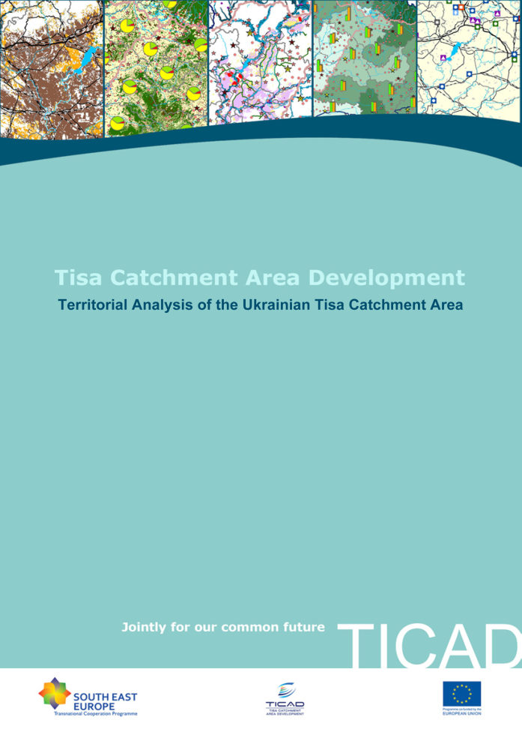
Tisa Catchment Area Development
South-East Programme
PROJECT “TICAD – Tisa catchment area development”
Common integrated strategy- European Tisa Region Strategy;
Common information and database (statistics, plans, programs, scientific documents);
Web-site (6 languages);
4 transnational pilot projects;
IT model program (possibilities for spatial planning);
Policy recommendations on Tisa catchment area development

Slide 14
Specific of sk-ua cross-border cooperation
Legislation differences
State border
Lack of strategies, programs and methodologies, including cross-border infrastructure development models
Differences in grant projects co-financing
Specific of State registration of grants and tax policy

Slide 15
CONtacts
Communal enterprise
«Аgency of regional development and cross-border co-operation «Transcarpathia» of Zakarpattia Oblast Council»
Bohomoltsa Str., 21, Uzhhorod
tel /fax (+380-312) 429994
E-mail: office@arr.com.ua,
Web-site: www.arr.com.ua
Facebook: Ard Transcarpathia
http://www.carpathianroad.com/contact#

