Slide 1
Local/regional planning and cross-border cooperation – incorporation of global threats
Košice 9 of March 2016
Sigrid Skålnes
Senior researcher
Department for regional studies
Sigrid.Skalnes@nbr.hioa.no

Slide 2
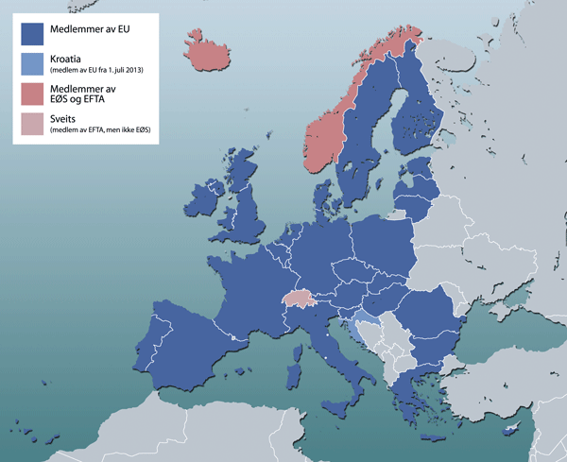
Border-regions in Europe
More than one third of EU citizens live and work in Europe's border regions. Long history of cross-border cooperation in different places in Europe
  In the Nordic countries – since 1952
  Different organizations for border regions established
  The Interreg programs (in the 90thies)
Different border regions and forms of co-operation
  Huge regions, sparsely populated, long distances, different languages
  «Neighbouring-regions» – smaller regions, the cross-border traffic pretty intense. Language – understand each other
  The national borders – (formal barriers (Schengen), but also (minor) barriers connected to taxes, social security
  Distances, lack of good communication lines, expensive transport
EU membership - cross-border regional development took a more prominent role in more sparsely populated territories
However, a significant economic potential remains untapped in the border areas due to a lack of trust or even the existence of negative attitudes among neighbouring countries
Notes:
-

Slide 3
Regional planning and global challenges
Global trends, cohesion policy, national policy, regional policy – what does the globaal trends mean for the local level (above-below)
Creating growth and jobs. Tackling climate change and energy dependence, and reducing poverty and social exclusion
Climate change ( «the green city/the walking city/the engaged city/the compact city/the diverse city/the including city»
Demografic changes
Increasing or decreasing population – reasons?
Sex – the gender pattern, how and why? And what does this mean for the society/for the future?
Ages – need for care, education, work, etc?
Migration - immigration/emigration – diversity? Challenging the local culture?
Refugees, asylum seekers
Labour market
  Common labor market across the border?
  Barriers/challenges (the border, tax systems, social security systems)
Education and competence
  Language
  Access to education
  Cooperation between different institutions (e.g. universities)
Health and care
  Public health
  Care for young/older – people to do this?
Infrastructure
  Communication and transportation – easy to cross the border(s)?
  Near/far from a market?

Slide 4
 | Local/regional | Global
 |  | Global trends, cohesion policy, regional polircy
Climate | Bio-gas (Nord: Lappland, Tornedalen) | Climate canges, resources Natural and tecnological changes
Labour and employment | Creating new jobs, developing the local society Nordland county: Local food as engine for local business (Innovation and the knowledge economy) The partnership consists of 13 partners from 9 countries (NO, SE, UK, CH, IT, ES, EH, SI and BG). Research and innovation, entrepreneurship Development, Evaluation and Optimization of Measures to Reduce the Impact on the Environment from Mining Activities in Northern Regions (NORD: Lappland, Norrbotten, Troms) Common labour market in the Nordic countries -
Communication, transportation and infrastructure | ROADEX-network set up to guarantee the reliability of roads, ensuring local residents have access to these community lifelines and to indigenous industries such as fishing, farming and forestry ( Finland, Scotland, Norway and Sweden and all of Greenland, Iceland and the Faroe Islands)
Education and competence | Acess to education NORPÅ –Adapting the vocational traing in the North Calotte (Nord: Finnmark, Troms, Nordland, Norrbotten) Karlstad University and Hedmark county
Health and care | Children, older people. Immigrants as health personell Innovative eHealth, care technology
Public security and protection | Preparing for Future Crisis Management (Sverige-Norge, Karlstad University: Hedmark, Värmland, Dalarne)

Slide 5
Thank you for your attention!

